Slide 1
Chapter 13: I/O Systems

Slide 2
Chapter 13: I/O Systems
I/O Hardware
Application I/O Interface
Kernel I/O Subsystem
Transforming I/O Requests to Hardware Operations
Streams
Performance

Slide 3
Objectives
Explore the structure of an operating system’s I/O subsystem
Discuss the principles of I/O hardware and its complexity
Provide details of the performance aspects of I/O hardware and software

Slide 4
13.1 Overview
Varied methods needed to control I/O devices， because they vary so widely in their function and speed.
These methods form the I/O subsystem of the kernel, which separates the rest of the kernel from the complexities of I/O devices.
I/O-device technology exhibits two conflicting trends
  Standardization of software and hardware interfaces
  Broad variety of I/O devices

Slide 5
Overview (Cont.)
To encapsulate the details and oddities of different devices, the kernel of an operating system is structured to use device-driver modules.
Device drivers
  Present a uniform device access interface to the I/O subsystem (such as system calls provide a standard interface between the application and the operating system.)

Slide 6
13.2 I/O Hardware
Incredible of I/O devices
Common concepts
  Port (包括四种寄存器：状态、控制、数据输入和数据输出)
  Bus (daisy chain or shared direct access)
  Controller (host adapter)
I/O instructions control devices
Devices have addresses, used by
  Direct I/O instructions
  Memory-mapped I/O

Slide 7

A Typical PC Bus Structure

Slide 8
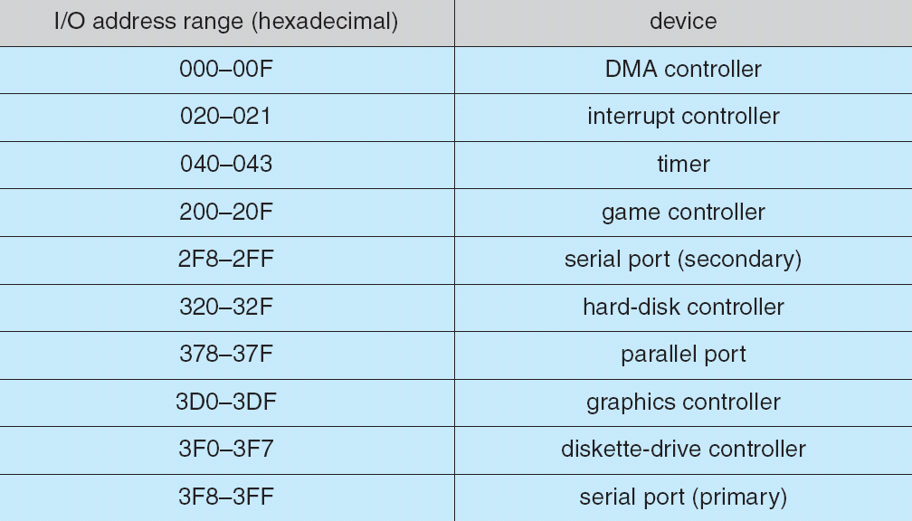
Device I/O Port Locations on PCs (partial)

Slide 9
I/O控制方式
所谓I/O操作的控制方式也就是外围设备和内存之间的数据传送控制方式，分为以下几种方式：
  程序直接控制方式(Polling)
  中断控制方式(Interrupts)
  DMA方式(Direct Memory Access)
  通道方式(Channel)

Slide 10
13.2.1 Polling
Polling or busy-waiting
Determines state of device
  command-ready
  busy
  Error
Reading the status register over and over until the busy bit becomes clear.
Busy-waiting cycle to wait for I/O from device

Slide 11
Polling (Cont.)
The basic polling operation is efficient, and provides a quick response for the I/O requests.
But polling becomes inefficient when it is attempted repeatedly yet rarely finds a device to be ready for service, while other useful CPU processing remains undone

Slide 12
13.2.2 Interrupts
CPU Interrupt-request line triggered by I/O device
Interrupt handler receives interrupts
Maskable to ignore or delay some interrupts
Interrupt vector to dispatch interrupt to correct handler
  Based on priority
  Some nonmaskable
Interrupt mechanism also used for exceptions

Slide 13
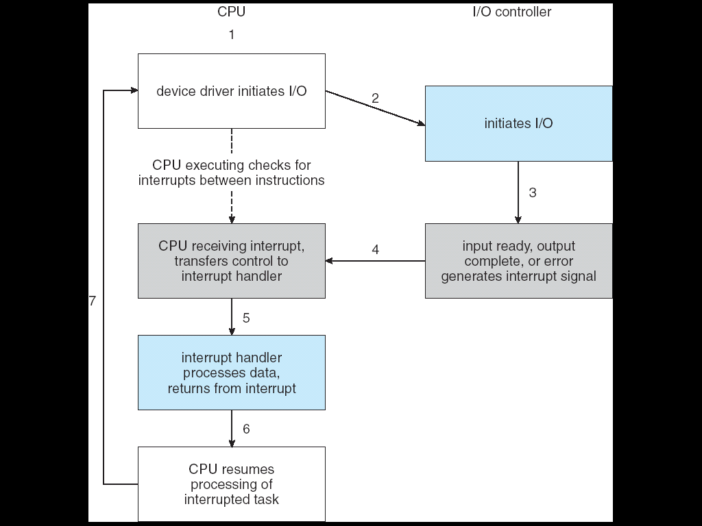
Interrupt-Driven I/O Cycle

Slide 14
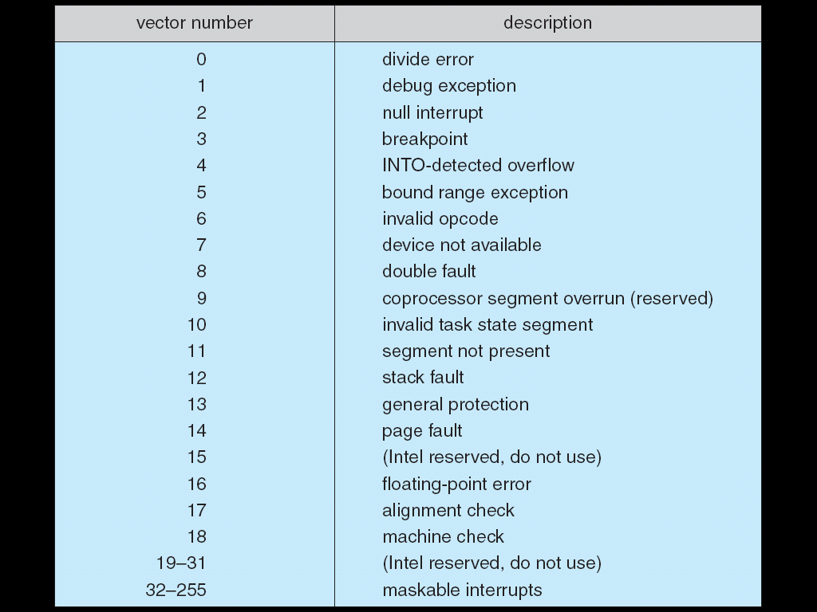
Intel Pentium Processor Event-Vector Table

Slide 15
12.2.3 Direct Memory Access(DMA)
Used to avoid programmed I/O for large data movement
Requires DMA controller
Bypasses CPU to transfer data directly between I/O device and memory

Slide 16

Six Step Process to Perform DMA Transfer

Slide 17
12.3 Application I/O Interface
Like other complex software-engineering problems, the approach here involves abstraction, encapsulation, and software layering
  See next page -A Kernel I/O Structure
Abstract away the detailed differences in I/O devices by identifying a few general kinds. Each general kind is accessed through a standardized set of functions---an interface.
The differences are encapsulated in kernel modules called device drivers that internally are custom-tailored to each device but that export one of the standard interfaces.

Slide 18
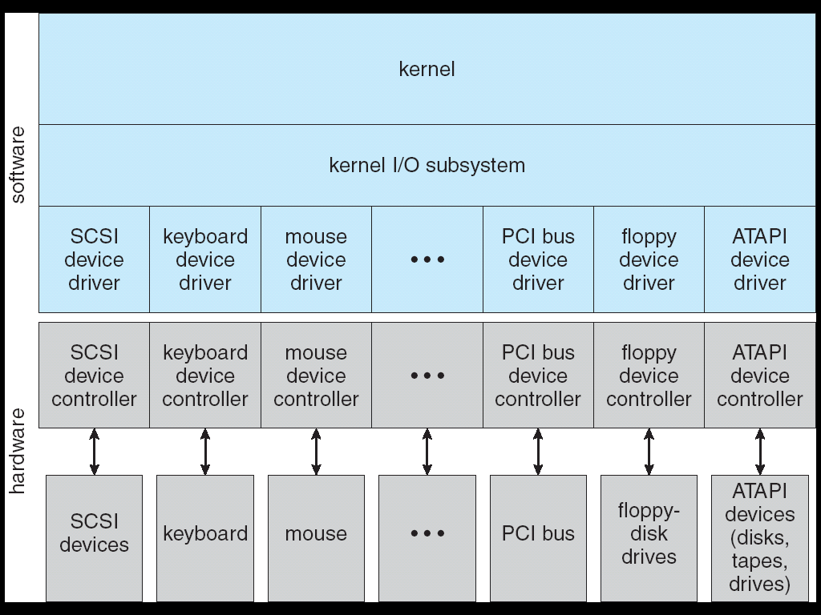
A Kernel I/O Structure

Slide 19
Application I/O Interface (Cont.)
I/O system calls encapsulate device behaviors in a few generic classes that hide hardware differences from applications.
Device-driver layer hides differences among I/O controllers from the I/O subsystem of the kernel
Making the I/O subsystem independent of the hardware simplifies the job of the operating-system developer.

Slide 20
Devices vary in many dimensions(page 507)
Character-stream or block
  A character-stream device transfers bytes one by one,
  A block device transfers a block of bytes as a unit.
Sequential or random-access
  A sequential device transfers data in a fixed order determined by the device
  The user of a random-access device can instruct the device to seek to any of the available data storage locations
Synchronous or asynchronous
  A synchronous device performs data transfers with predictable response times.
  An asynchronous device exhibits irregular or unpredictable response times.

Slide 21
Devices vary in many dimensions（page 507）
Sharable or dedicated
  A sharable device can be used concurrently by several processes or threads; a dedicated device cannot.
Speed of operation
  Device speeds range from a few bytes per second to a few gigabytes per second.
Read-write, read only, or write only
  Some devices perform both input and output, but others support only one data direction.

Slide 22
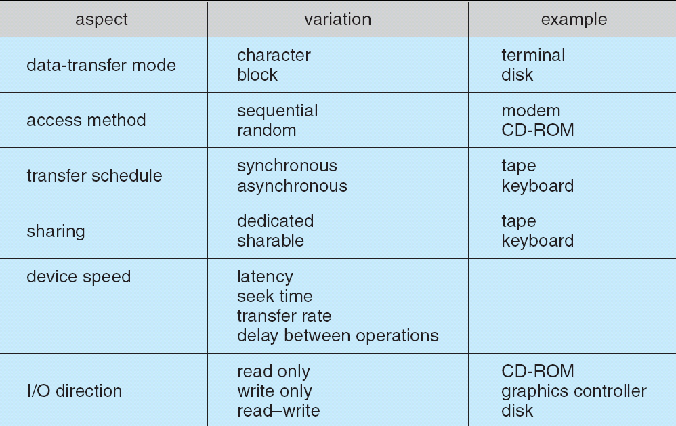
Characteristics of I/O Devices

Slide 23
13.3.1 Block and Character Devices
Block devices include disk drives
  Commands include read, write, seek
  Raw I/O or file-system access
  Memory-mapped file access possible
Character devices include keyboards, mice, serial ports
  Commands include get, put
  Libraries layered on top allow line editing

Slide 24
13.3.2 Network Devices
Varying enough from block and character to have own interface
Unix and Windows NT/9x/2000/xp include socket interface
  Separates network protocol from network operation
  Includes select functionality
Approaches vary widely (pipes, FIFOs, streams, queues, mailboxes)

Slide 25
13.3.3 Clocks and Timers
Provide current time, elapsed time, timer
Programmable interval timer used for timings, periodic interrupts
ioctl (on UNIX) covers odd aspects of I/O such as clocks and timers

Slide 26
13.3.4 Blocking and Nonblocking I/O
Blocking - process suspended until I/O completed
  Easy to use and understand
  Insufficient for some needs
Nonblocking - I/O call returns as much as available
  User interface, data copy (buffered I/O)
  Implemented via multi-threading
  Returns quickly with count of bytes read or written
Asynchronous - process runs while I/O executes
  Difficult to use
  I/O subsystem signals process when I/O completed

Slide 27
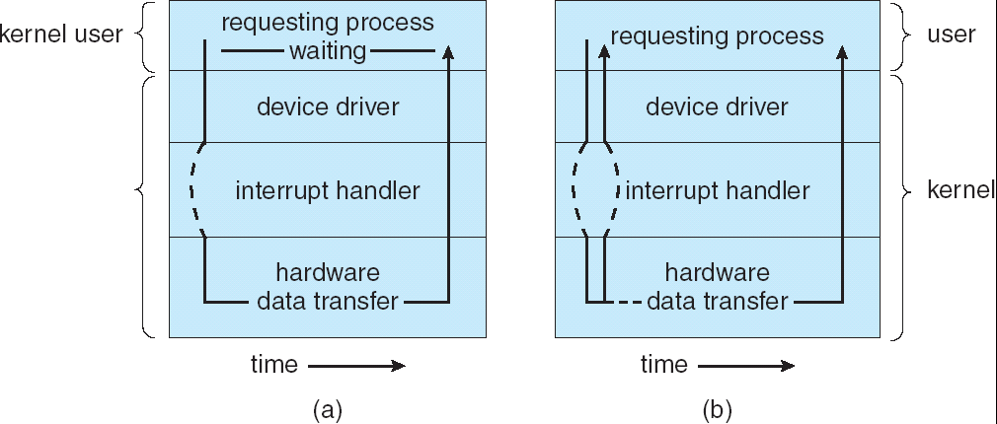
Two I/O Methods
Synchronous
Asynchronous

Slide 28
13.4 Kernel I/O Subsystem
Kernels provide many services related to I/O
  Scheduling
  Buffering
  Caching
  Spooling and Device Reservation
  Error Handling
  I/O Protection

Slide 29
13.4.1 I/O Scheduling
Scheduling (Non-preemptive，FCFS)
  Some I/O request ordering via per-device queue
  Some OSs try fairness

Slide 30
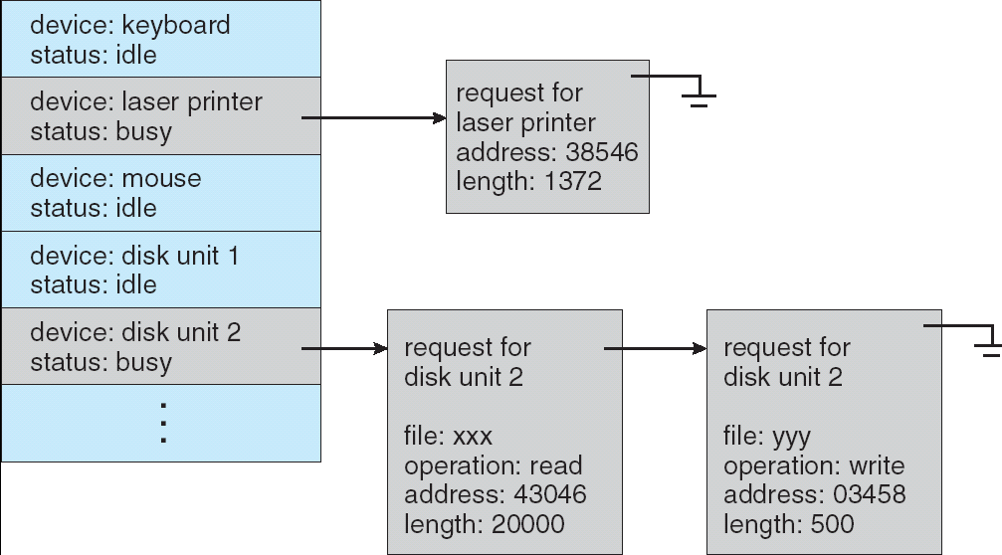
Device-status Table

Slide 31
13.4.2 Buffering
A buffer is a memory area that stores data while they are transferred between two devices or between a device and an application.
Buffering - store data in memory while transferring between devices
Why buffering?

Slide 32
Why buffering
To cope with device speed mismatch
(between the producer and consumer of a data stream)
To cope with device transfer size mismatch
To maintain “copy semantics”
  application buffer & kernel buffer
  e.g. write system call

Slide 33
Why buffering (Cont.)
To cope with device speed mismatch (between the producer and consumer of a data stream)
  for example, a file is being received via modern for storage on the hard disk.
  a buffer is created in main memory to accumulate the bytes received from the modem.
  When all entire buffer of data has arrived, the buffer can be written to disk in a single operation.

Slide 34
Why buffering (Cont.)
To cope with device transfer size mismatch
  Buffers are used widely for fragmentation and reassembly of messages in computer networking.
  At the sending side, a large message is fragmented into small network packets. The packets are sent over the network.
  The receiving side places them in a reassembly buffer to form an image of the source data

Slide 35
Why buffering (Cont.)
To maintain “copy semantics” for application I/O
  E.g. write() system call
    Suppose that an application has a buffer of data that it wishes to write to disk
    It calls the write () system call
    After the system call returns, what happens if the application changes the contents of the buffer?
    With copy semantics, the version of the data written to disk is guaranteed to be the version at the time of the application system call, independent of any subsequent changes in the application's buffer.

Slide 36
Why buffering (Cont.)
To maintain “copy semantics” for application I/O
  E.g. write() system call
  Several ways for the operating system to guarantee copy semantics
  Application buffer & kernel buffer
      The write() system call copy the application data into a kernel buffer before returning control to the application.
      The disk write is performed from the kernel buffer, so that subsequent changes to the application buffer hat no effect.
The same effect can be obtained more efficiently by clever use of virtual memory mapping and copy-on-write page protection.

Slide 37
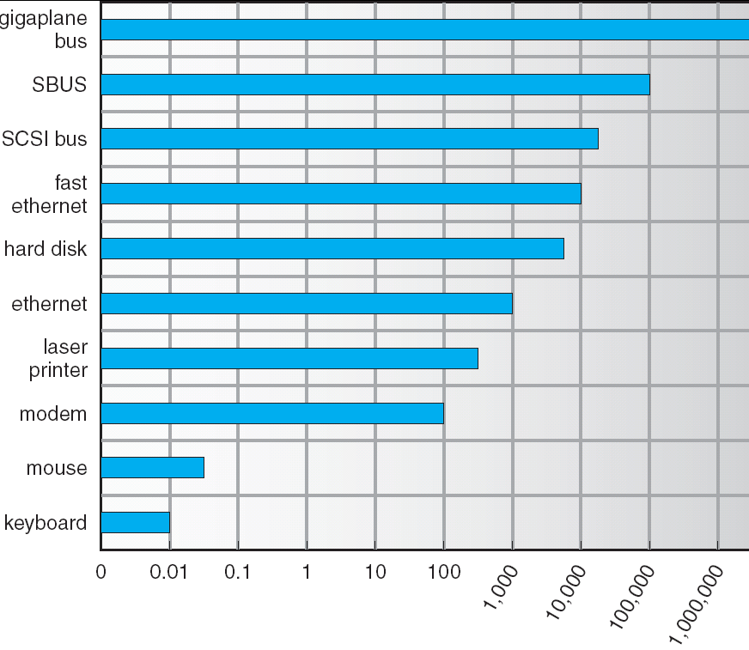
Sun Enterprise 6000 Device-Transfer Rates

Slide 38
13.4.3 Caching
Caching - fast memory holding copy of data, access to the cached copy is more efficient than access to the original one.
  Always just a copy
  Key to performance
The difference between a buffer and a cache is that a buffer may hold the only existing copy of a data item, whereas a cache, by definition, just holds a copy on faster storage of an item that resides elsewhere.

Slide 39
13.4.4 Spooling and Device Reservation
SPOOLing - hold output for a device
  A spool is a buffer that holds output for a device, such as a printer, that cannot accept interleaved data streams
  Although a printer can serve only one job at a time, several applications may wish to print their output concurrently, without having their output mixed together.
  The operating system solves this problem by intercepting all output to the printer.
  Each application's output is spooled to a separate disk file.
  When an application finishes printing, the spooling system queues the corresponding spool file for output to the printer.
  The spooling system copies the queued spool files to the printer one at a time.

Slide 40
13.4.4 Spooling and Device Reservation
Device reservation - provides exclusive access to a device
  Spooling is one way operating systems can coordinate concurrent output.
  System calls for allocation and deallocation devices
    Another way to deal with concurrent device access is to provide support for exclusive device access by enabling a process to allocate an idle device and to deallocate that device when it is no longer needed.
  Watch out for deadlock
  E.g. tapes, printers.

Slide 41
13.4.5 Error Handling
OS can recover from disk read, device unavailable, transient write failures
Most return an error number or code when I/O request fails
System error logs hold problem reports

Slide 42
13.4.6 I/O Protection
User process may accidentally or purposefully attempt to disrupt normal operation via illegal I/O instructions
  All I/O instructions defined to be privileged
  I/O must be performed via system calls
    Memory-mapped and I/O port memory locations must be protected too

Slide 43
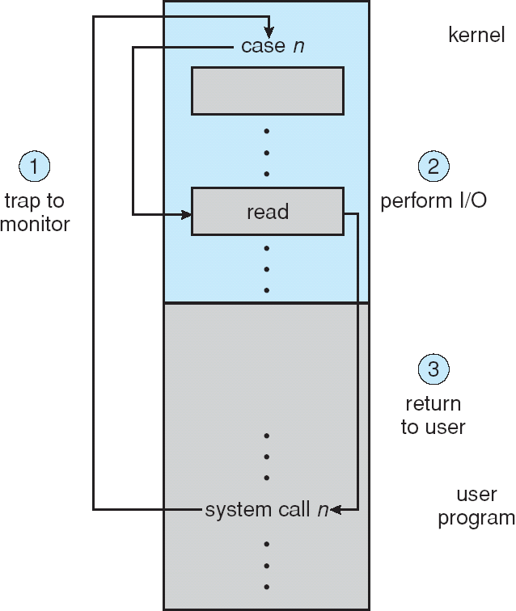
Use of a System Call to Perform I/O

Slide 44
13.4.7 Kernel Data Structures
Kernel keeps state information for I/O components, including open file tables, network connections, character device state
Many, many complex data structures to track buffers, memory allocation, “dirty” blocks
Some use object-oriented methods and message passing to implement I/O

Slide 45
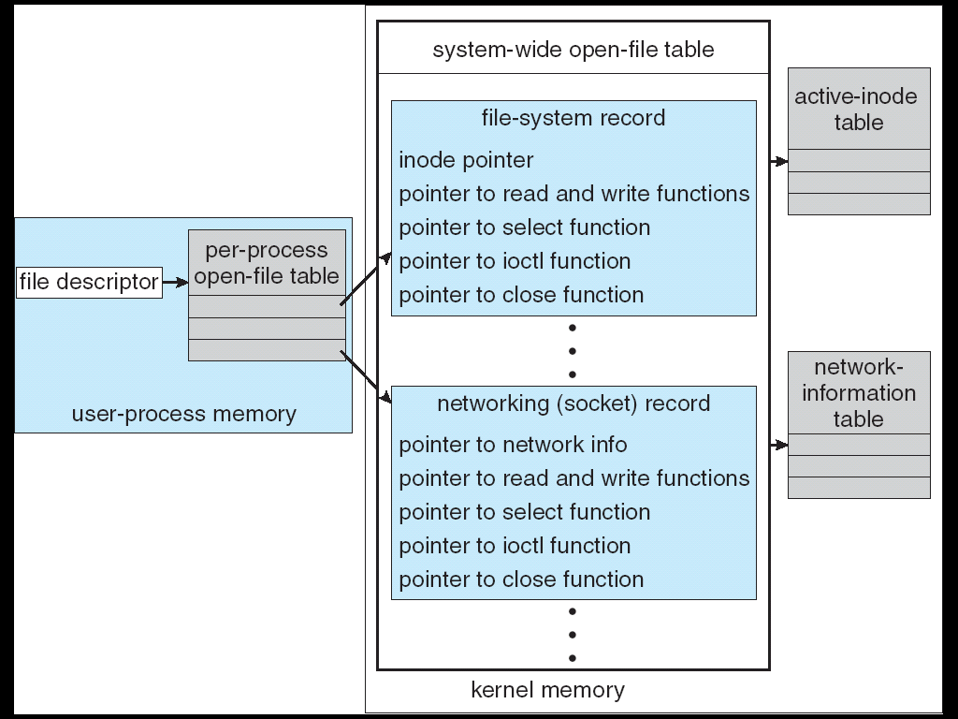
UNIX I/O Kernel Structure

Slide 46
13.5 Transforming I/O Requests to Hardware Operations
Consider reading a file from disk for a process:
  Determine device holding file
  Translate name to device representation
  Physically read data from disk into buffer
  Make data available to requesting process
  Return control to process

Slide 47
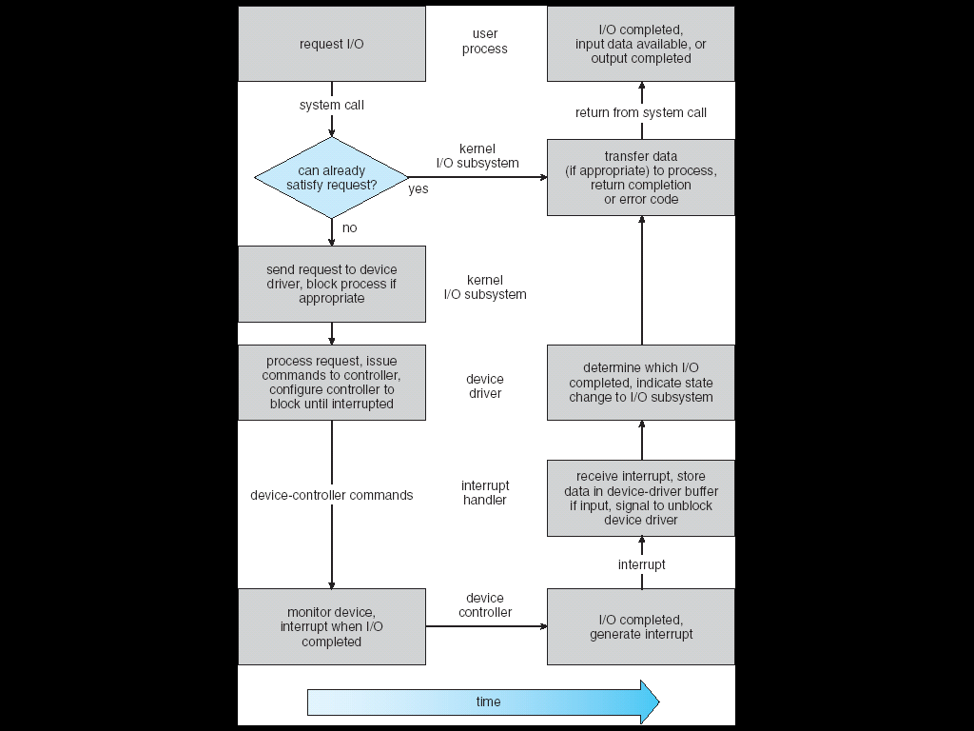
Life Cycle of An I/O Request

Slide 48
13.6 STREAMS
STREAM – a full-duplex communication channel between a user-level process and a device in Unix System V and beyond
A STREAM consists of:
- STREAM head interfaces with the user process
- driver end interfaces with the device
- zero or more STREAM modules between them.
Each module contains a read queue and a write queue
Message passing is used to communicate between queues

Slide 49
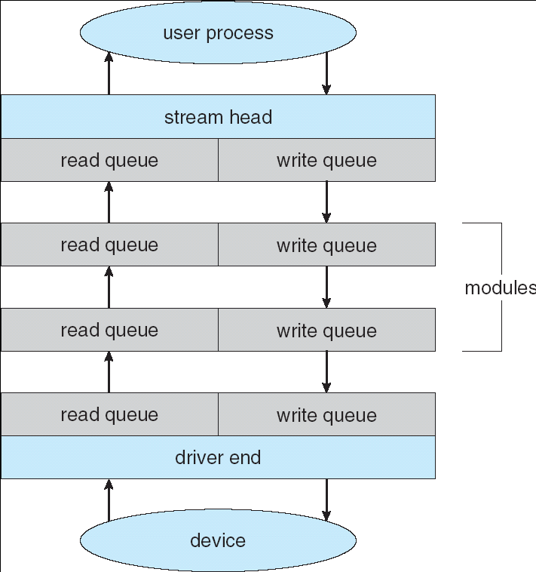
The STREAMS Structure

Slide 50
13.7 Performance
I/O is a major factor in system performance:
  Demands CPU to execute device driver, kernel I/O code
  Context switches due to interrupts (as processes block and unblock)
  Data copying (between controller and physical memory, and between kernel buffers and application data space, can loads down the memory bus)
  Network traffic especially stressful (causes a high context-switch rate)

Slide 51
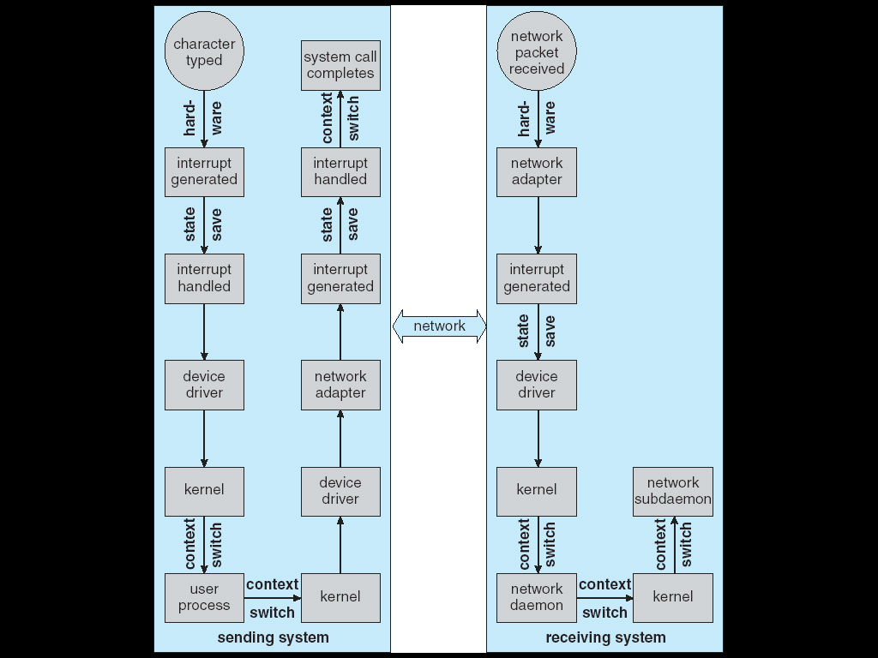
Intercomputer Communications

Slide 52
Improving Performance
Reduce number of context switches
Reduce data copying
Reduce interrupts by using large transfers, smart controllers, polling (if busy waiting can be minimized)
Use DMA or channel (to offload simple data copying from CPU)
Balance CPU, memory, bus, and I/O performance for highest throughput

Slide 53
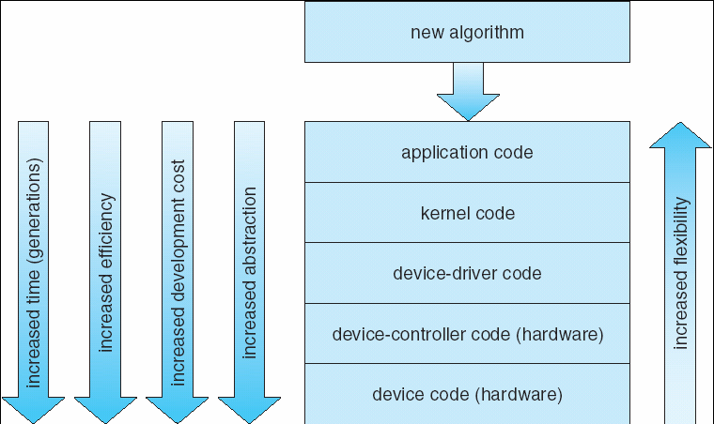
Device-Functionality Progression

Slide 54
设备独立性
概念
应用程序独立于具体使用的物理设备
逻辑设备与物理设备
- 在应用程序中使用逻辑设备名称来请求使用某类设备；在系统的实际执行时，使用物理设备名称；
- 系统完成从逻辑设备到物理设备的映射－LUT
优点
- 设备分配时的灵活性；
- 易于实现I/O重定向(借助于LUT)；

Slide 55
SPOOLing技术
SPOOling
  Simultaneous Peripheral Operations On Line
  外部设备联机并行操作
  又称为假脱机
脱机输入是利用专门的外围控制机将低速I/O设备上的数据预先输入到磁盘上，然后主机从磁盘上直接读取输入数据；
脱机输出是主机先将输出数据写入到磁盘上，然后利用专门的外围控制机将磁盘上的数据在低速I/O设备上输出；
脱机I/O的采用提高了主机的输入输出速度；
SPOOLing技术利用一台可共享的、高速大容量的块设备（通常是硬盘）来模拟独享设备的操作，使一台独享设备变为多台可并行使用的虚拟设备，即把独享设备变为逻辑上的共享设备；
  类似于分时技术将一个CPU映射为多个CPU
给人的感觉就像是系统具有速度非常高的I/O设备；（如Printer）

Slide 56
SPOOLing技术
SPOOLing技术利用输入进程与输出进程模拟脱机I/O中的专用的I/O控制机；
因此将SPOOLing称为联机情况下实现的外围操作；也称为假脱机操作；
采用SPOOLing技术，
  当用户提交一个文档给打印机时，系统为该打印请求在磁盘上创建了一个文件，然后将欲打印的文档内容写入该文件中
  同时在系统的打印队列中建立一张打印表
  系统依次将打印对列中的打印请求提交打印机打印
  可以理解为：基于SPOOLing技术，OS将物理打印机虚拟为磁盘上的一个文件；

Slide 57
SPOOLing系统的组成
输入井与输出井
￭ 在磁盘上开辟的两块存储空间；
￭ 输入井模拟脱机输入时的磁盘，收容输入数据；
￭ 输出井模拟脱机输出时的磁盘，收容输出数据；
输入缓冲区与输出缓冲区（buffer）
￭ 在内存中开辟的两个缓冲区
￭ 输入缓冲区用于暂存输入设备输入的数据，然后传送到输入井；
￭ 输出缓冲区用于暂存从输出井来的数据，然后传送给输出设备；
输入进程与输出进程
￭ 输入进程将用户要求的数据从输入设备通过输入缓冲区送到输入井；当CPU需要输入数据时，直接从输入井中读入；
￭ 输出进程将用户需要输出的数据送入输出井；当输出设备空闲时，从输出井读出数据，通过输出缓冲区送入输出设备上；
请求输出队列
￭ 系统为每个请求输出的进程建立一张请求输出表；若干张请求输出表形成一个请求输出队列；当输出设备空闲时，按该队列的顺序依次输出；

Slide 58
SPOOLing工作过程举例
以共享打印机为例
当用户请求输出时，SPOOLing系统截获该请求，然后并不将真正的打印机分配给该用户进程，而只是为它做了两件事：
(1) 由输出进程在输出井中为之申请一空闲存储空间，并将打印的数据写入其中；
(2) 输出进程再为用户申请一张空白的用户请求打印表，并将用户的打印要求填入其中，再将该表挂接到请求打印队列中；
如果还有打印请求，SPOOLing系统仍然截获该请求，同样为它做上述两件事；
当打印机空闲时，输出进程将从打印队列中取出队首的一张请求打印表，根据表中的要求，将要打印的数据从输出井中传送到输出缓冲区，再由打印机打印；
重复该过程，直至打印队列为空；输出进程将自己阻塞，直至新的打印请求将其唤醒；

Slide 59
SPOOLing系统的特点
采用SPOOLing技术管理打印机，给用户的感觉就像是每个用户独占了一台速度很高的打印机－虚拟打印机；否则用户进程将依次等待低速的打印机打印数据，降低了进程的推进速度；
因此我们说利用SPOOLing技术将一台物理设备改造成多台虚拟设备；
特点
￭ 提高了I/O的速度；
￭ 将独占设备改造成共享设备；
￭ 实现了虚拟设备；

Slide 60
Homework
P526: 6,9,11
Discussion
1、device driver
2、I/O is a major factor in system performance，why?
3、How to improve I/O subsystem performance?
4. Buffer、cache之概念以及引入它们的原因
5、几种I/O控制方式之比较
6、I/O设备的保护
7、设备的分类
8、SPOOLing的组成、思想；

Slide 61
End of Chapter 13

